Slide 1
Hunting the Bad Guys: Using OSINT, Social Media & other tools within Splunk
NOVA CyberCon 2018
Jake Babbin – Copper River Enterprise Services

Slide 2








About Me
Over 15 year career spanning a variety of customers in US Military, Intelligence Community, and Federal Law Enforcement
Published Author
Speaker at Security Conferences, assistant instructor
Currently
Architect Engineer, Copper River Enterprise Services
Prior
Director of Threat Intelligence, The Crypsis Group
Practice Director – Incident Response and Forensics McAfee/Intel Security (Americas)
Incident Response Auditor for DoD CIO CND-SP/CCRI team
Lead Analyst The White House Security Operation Center (EOP)
Founded The White House Cyber Threat Cell

Slide 3
Agenda
Data Enrichment – why should we care ?
Splunk and Geo-location
Splunk enrichment options Examples - 3rd Party Data
Twitter Data
Status and information
Data Enrichment New ideas
Shodan
Censys
Demo
Conclusion

Slide 4

Data Enrichment – why should we care ?

Slide 5

Tracking user activity
Contractor who sold their RSA token to stay at home watching cat videos and going out
“He physically FedExed his RSA [security] token to China”
U.S.-based company discovered its computer systems were being accessed from China
Company's own employee gave access to Chinese programmers he personally outsourced
Employee, known as "Bob", seen as "someone you wouldn't look at twice in an elevator"
"Bob" earned several hundred thousand dollars a year, paying Chinese firm $50,000 a year
Even kept a schedule “The Verizon team even found that "Bob" kept a regular schedule at his office:
9:00 a.m. – Arrive and surf Reddit for a couple of hours. Watch cat videos
11:30 a.m. – Take lunch
1:00 p.m. – Ebay time.
2:00 – ish p.m Facebook updates – LinkedIn
4:30 p.m. – End of day update e-mail to management.
5:00 p.m. – Go home”

Slide 6
Lessons Learned from “Cat Video” User
Bottom line – could have been caught with a single Geo-location lookup in Splunk
Control physical access to security devices
Possibly require physical validation/maintenance of devices on some time window (1 year, etc)
Setup Geo-location fencing
For remote/home users trace the originating IP for matching
Some ISPs and geo-location data may only put in approximate location
Create and coordinate with HR locations or home sites for remote users
For travel implement a travel tracking system
Create asset tracking system
Provides endpoint validation for other security requirements
Current AV levels, security posture, etc prior to allowing VPN access

Slide 7
Splunk and Geo-location

Slide 8
Splunk and Geo-location
Crash course into Maxmind
Splunk uses Maxmind’s GeoLite2 databases to match IPv4 addresses to physical locations
Can be referenced in Splunk searches using an SPL command ‘iplocation’
Mysearch | iplocation <field>
Outputs contain Latitude, Longitude, Country, City, address

Slide 9
Maxmind and Splunk
Maxmind is a company who tracks IPv4 addresses (now also tracks IPv6)
Provide geographic coordinate information about the IP address.
Data is provided in a 2 formats (GeoIP2Country, GeoIP2City) that are paid allowing for updates and accurate
Also available in a Free format (GeoLiteIP2Country).
Major differences are in updates and accuracy.
Provide API access in a variety of languages

Slide 10
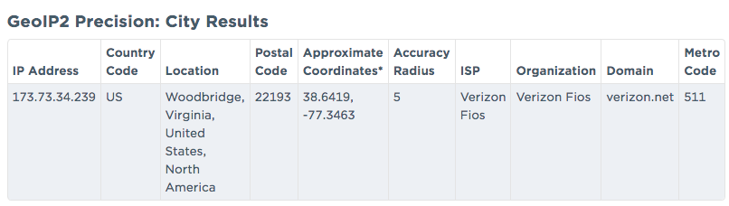
IP Geo-Location 101
Definition
Term for matching IPv4 addresses to their closest Latitude/Longitude coordinates
Several services perform this lookup and reference information
Maxmind, LLC is the major provider of this service
Usually closest match is the datacenter or area of a major Internet Service Providers office.
Below – an example of the full Maxmind data record (from Maxmind Product GeoIP2City)

Slide 11
Getting Splunk to update maxmind
Previous work TA-Geoip (https://github.com/georgestarcher/TA-geoip)
Updated work Script and Splunk app (Deploy among Search Heads) http://blog.hortonew.com/splunk-automatically-update-geoip-database-across-environment
Notes:
NOTE When it first gets pushed out, it won’t download anything. Just manually run the shell script once. All subsequent times will be automatic.

Slide 12
Splunk and updating Maxmind
Splunk ships with a copy of Maxmind’s free product GeoLite2-City
Stored in ‘%SPLUNK_HOME%/share/’
IP’s change ownership, but the shipped version of the database doesn’t between Splunk releases.
How to update Splunk’s Maxmind GeoLite2-City database
Create an app on your Deployment Server – Splunk_int_geoip
%SPLUNK_HOME%/etc/deployment-apps/Splunk_int_geoip
…/Bin/
……get_maxmind_db.sh
…/default/
…….inputs.conf
…….limits.conf
Great example used is from http://blog.hortonew.com/splunk-automatically-update-geoip-database-across-environment

Slide 13
Splunk and updating Maxmind - contd
----- get_maxmind_db.sh
#!/bin/bash # Author: Andrew Wurster # Date: 13 Jan 2015 cd/opt/splunk/etc/apps/Splunk_int_geoip/bin wget -O GeoLite2-City-Latest.mmdb.gz http://geolite.maxmind.com/download/geoip/database/GeoLite2-City.mmdb.gz || {echo'Could not download MaxMind GeoIP DB, exiting.';exit1; } gunzip -f GeoLite2-City-Latest.mmdb.gz chmod 644 GeoLite2-City-Latest.mmdb
----- inputs.conf
# Download at 11pm the 1st Tuesday of the month
[script:///opt/splunk/etc/apps/Splunk__int_geoip/bin/get_maxmind_db.sh] index = main interval = 0 23 1-7 * 2 sourcetype= splunk_geoip disabled=false ------ limits.conf
# redirects the defalt location to this app’s directory
[iplocation] db_path = /opt/splunk/etc/apps/Splunk_int_geoip/bin/GeoLite2-City-Latest.mmdb

Slide 14
Splunk enrichment options

Slide 15
Splunk enrichment options
Splunk Natively has several options available
Lookups – Called in SPL (Splunk Processing Language) Queries
File based
Geolocation
External (scripts)
KV Store
Automatic lookups – Added to content and fields automatically
Useful for Web Log data to automatically convert HTTP field Codes to Common Names
Adding site and location information to logs such as VPN data, endpoints, etc

Slide 16
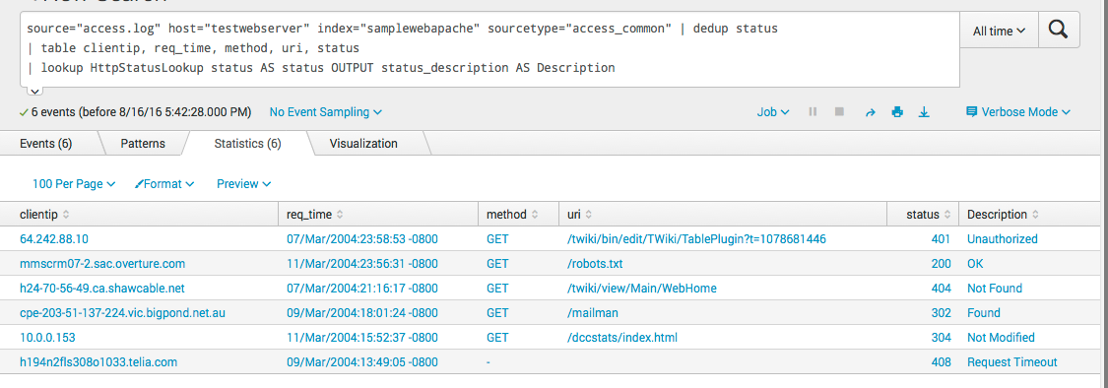
Lookup Definitions – Give that data context
Splunk Community created a CSV file for HTTP Status messages.
http://wiki.splunk.com/Http_status.csv
Fields:
Status, status_description, status_type
Create a Lookup File and Definition
Call Lookup and provide Output column
Mysearch | Lookup HttpSstatusLookup status AS status OUTPUT status_description AS Description

Slide 17
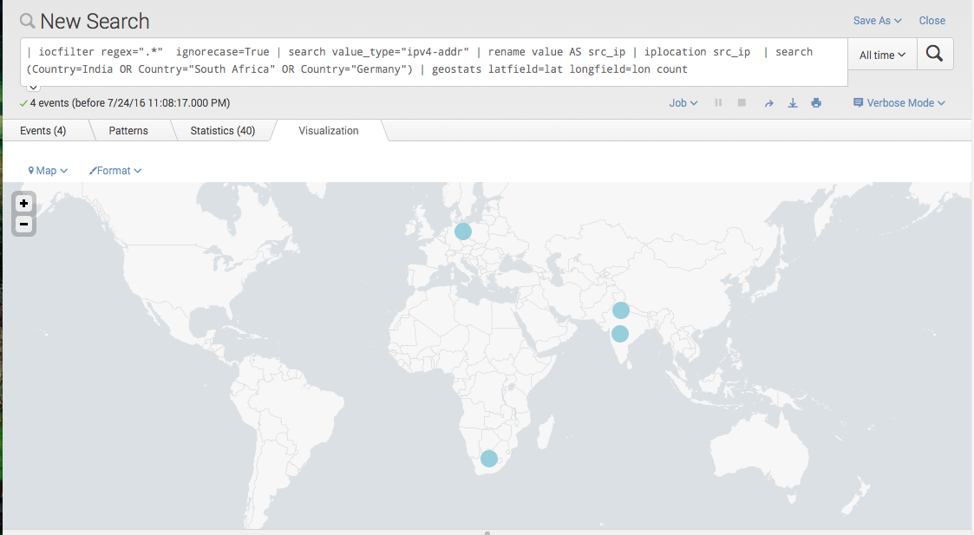
Easy Win - Geo-location Mapping
Simple Country filtering
Mysearch | iplocation src_ip | search (Country=India OR Country="South Africa" OR Country="Germany") | geostats latfield=lat longfield=lon count
Splunk embedded commands used
iplocation/geostats – geo-coding information
geom - Allows for Geo-fencing framing via polygons
geomfilter – geo-fencing limiting
| IOCfilter regex=“.*” ignorecase=True | search value_type=”ipv4-addr” | rename value as src_ip | iplocation src_ip | search (Country=India OR Country=“South Africa” OR Country=“Germany”) | geostats latfield=lat longfield=lon count
Notes:
IP’s mapped here are from sample set from IOCbucket ‘indicators of compromise’ to simply provide an example of mapping

Slide 18

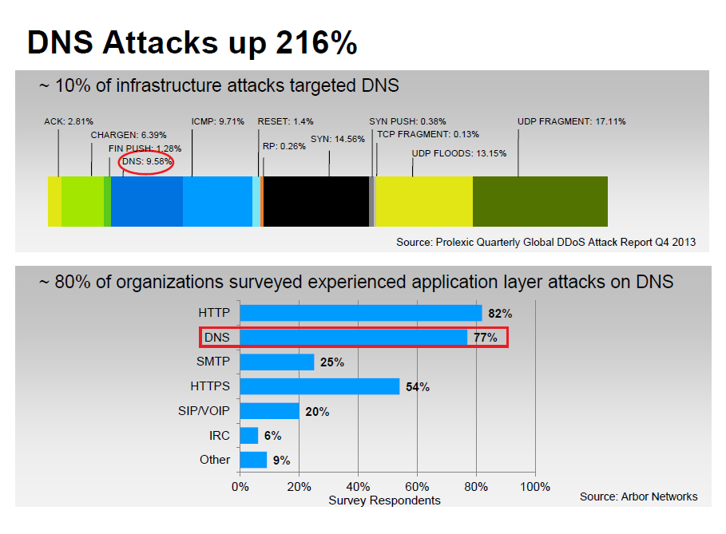

Real-world Example: Suricata: Protocol Analysis DNS
Fun things to do with DNS data
Find out who’s mapping your network using DNS index=CUSTOMER_sec_suricata event_type=dns dns.type=query AND dns.rrname="*.CUSTOMER_DOMAIN" AND src_ip!=”CUSTOMER_IP.*" | stats count values(dns.rrname) by dns.rrtype, src_ip | sort – count
Find a specific country that is walking DNS to get information
Example: Libya index=CUSTOMER_sec_suricata event_type=dns dns.type=query AND dns.rrname="*.CUSTOMER_DOMAIN" AND src_ip!=”CUSTOMER_IP.*" | iplocation src_ip | search Country="Libya" | stats count values(dns.rrname) by dns.rrtype, src_ip | sort – count

Slide 19
Interacting with External Commands Tor Tracking

Slide 20
TOR lookups
The Tor Project – Provides both web and script access to public repository information related to the Tor network – https://metrics.torproject.org
Hosts are broken down into functions
Exit Nodes – End points from the Tor network to the public Internet
Directory Servers – Onion network routing control servers
Bridges – Control connections between Tor clients, Directory Servers and Exit Nodes
Example IP: 162.247.72.201

Slide 21
Interacting with External Commands
Interacting with other API’s Lookups, search scripts and more
Search for an IP address to see if it's part of the Tor
index=security_logs sourcetype=nids | lookup torlookup ip AS clientip OUTPUT torvalue AS TorInfo | fillnull value=NotTorHost TorInfo | table sourcetype. clientip, TorInfo
Positive Hit
Negative Hit – (Custom result)
NotTorHost
Notes:
Running External Scripts as commands Script – lives in $SPLUNK_HOME/etc/apps/<APPNAME>/bin Simplicity just use ’search’ for the default Search and Reporting app Edit ‘commands.conf’
[commandNameInSplunk]
Filename = <SCRIPT_NAME> Type = <LANGUAGE>
Simple Python script example to use as reference
http://www.georgestarcher.com/splunk-a-dns-lookup-for-abuse-contacts/

Slide 22
How We do this? – Walkthrough

Slide 23
Demo – Walkthrough
Script uses external lookup from DNS for a hosted site
Dan.co.uk maintains a DNS response that lists Tor information about IP
https[:]www.dan.me.uk/dnsbl
Take IPv4 address (Can to IPv6)
Reverse the IP to embed it into a DNS A record query 192.2.0.123 123.0.2.192.torexit.dan.me.uk
Response
If IP is a match response will be A record of 127.0.0.100
Following up with a TXT record with extra information
N:<nodename>/P:<port1[,port2]>/F:<flags>
Grab Response data Add Flag Info return results to Splunk
BUILD THE SPLUNK LOOKUP COMMAND/SCRIPT
Apply to transforms.conf
$SPLUNK_HOME/etc/system/local/ #
# Lookup NAME [torlookup]
External_cmd = Tor_DNS_lookup.py EXT_IP TorResult
Fields_list = EXT_IP, TorResult RUN A SEARCH index=zimperium "threat.general.external_ip"="*" | stats count by threat.general.external_ip, "threat.name" | rename "threat.general.external_ip" AS EXT_IP | lookup torlookup EXT_IP OUTPUT TorResult | table EXT_IP,"threat.name", TorResult

Slide 24
More Examples – 3rd Party Data

Slide 25
Examples - 3rd Party Data
JSON twitter
Follow Marai iot botnet
Keywords of interest / brand status
Catalog leaks pastebins
Shodan
Lookup and pivots
HL App

Slide 26
Twitter Data

Slide 27
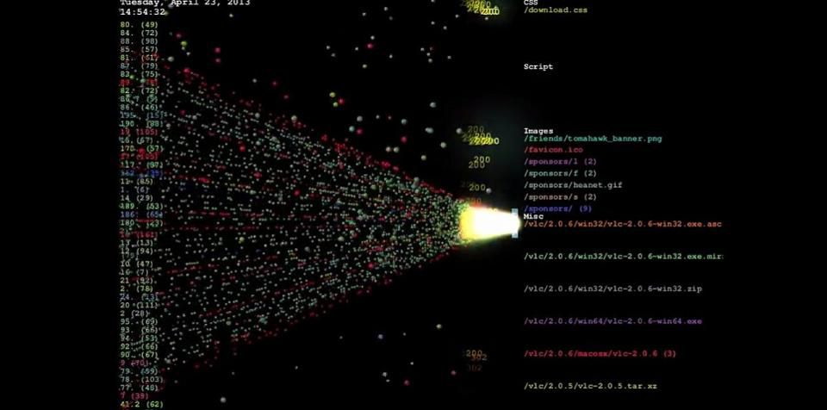
Follow that botnet –Marai IOT botnet
Background
Mirai(Japanese for "the future", 未来) is a malware that turns networked devices running Linux into remotely controlled "bots" that can be used as part of a botnet in large-scale network attacks. It primarily targets online consumer devices such as IP cameras and home routers. The Mirai botnet was first found in August 2016 by MalwareMustDie, a whitehat malware research group, and has been used in some of the largest and most disruptive distributed denial of service (DDoS) attacks, including an attack on 20 September 2016on computer security journalist Brian Krebs's web site, an attack on French web host OVH, and the October 2016 Dyn cyberattack. According to a leaked chat log between Anna-senpai and Robert Coelho, Mirai was named after the 2011 TV anime series Mirai Nikki.
- Wikipedia -https://en.wikipedia.org/wiki/Mirai_(malware)
Notes:
Background Reading
https://www.hackread.com/mirai-botnet-linked-to-dyn-dns-ddos-attacks/ https://www.forbes.com/sites/leemathews/2016/11/29/worlds-biggest-mirai-botnet-is-being-rented-out-for-ddos-attacks/#3027488a58ad

Slide 28
Twitter tracking of Mirai Botnet
Internet researchers (2sec4u and MalwareTechBlog) started a live feed of the DDoS Ips used in the Mirai botnet.
Twitter Posts contain information such as IP, attack type, name, duration and protocol
Lets use that to store into Splunk!
Twitter can be logged into Splunk using a JSON RESTful endpoint.
Follow the handle you want ‘@MiraiAttacks’ in this case.
Dump the Twitter text and parse for fields
Add to a lookup table?, Compare to other threat feeds/info available in Splunk

Slide 29
Get that threat Intel
Example of using Twitter data
Parse Twitter index for ‘tweets’ ( message info)
Then look for my handle of interest ’@MiraiAttacks’
Then make sure the tweet has an IPv4 address as part of the tweet
Extract fields for parsing
BotnetNumber – Internal tracker
BotnetProto – Type of IP protocol used
BotnetDuration – Time (seconds) for the attack
BotnetTarget – IPv4 address
BotnetCIDR – CIDR notation for the IP (in case not a single IP (/32)
index=socialmedia sourcetype=twitter_tweet | rename user.screen_name AS "Handle", count AS "Num_Tweets" | search Handle=MiraiAttacks | regex text="\d{1,3}\.\d{1,3}\.\d{1,3}\.\d{1,3}” | rex field=text "\w+\s\W(?<BotnetNumber>\d+)\s\-\s(?<BotnetProto>\w+)\s\w+\w+\w+\s\w+\s(?<BotnetDuration>\d+)\s\w+\s\[\w+\]\s(?<BotnetTarget>\d+\.\d+\.\d+\.\d+)\S(?<BotnetCIDR>\d+)” | stats count values(BotnetTarget) by BotnetNumber

Slide 30
Another Example – Record/Follow Twitter Feed

Slide 31
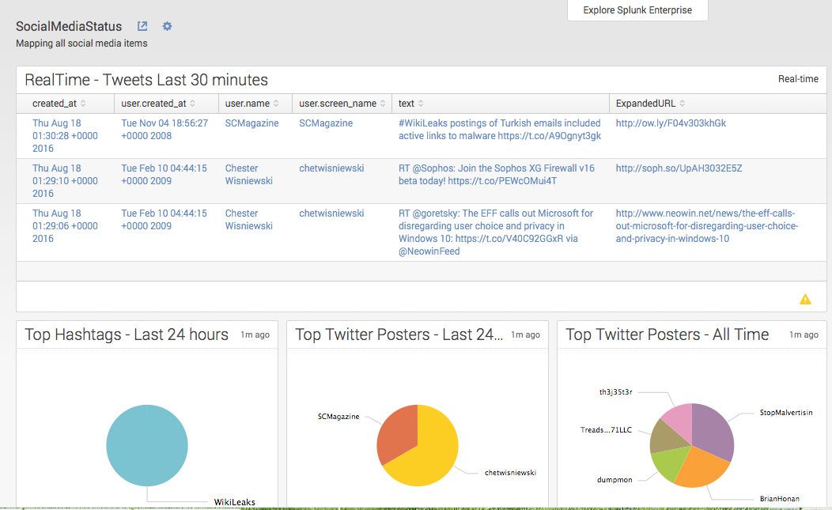
Social Media Dashboard
Quick Stats
Useful for Profile/brand status and awareness
Example Content
Last 30 minutes of tweets
Last 24 Hours
Top Hashtags
Top Posters
All Time
Top Poster

Slide 32
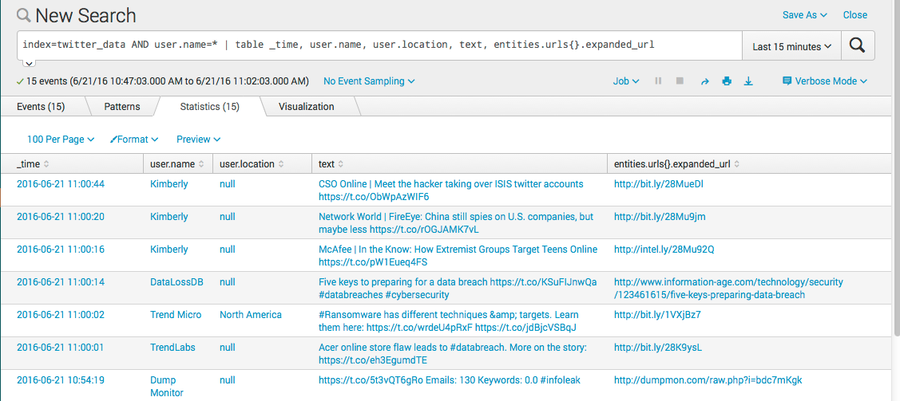
Lazy me – recording and tracking my twitter feed in splunk
REST API as data input (It’s only JSON right? ☺ )
Store in index only for messages, urls and names for now
Run a lookup of ‘dirty’ words then add to alert
Generates a daily report of tweets per day

Slide 33
Collect Leaked Information - Pastebin
Twitter Handle ‘dumpmon’ reports and links to pastebin and pastie posts that appear to have leaked information in them.

Slide 34
Situational Awareness (SITREP)

Slide 35
Status and information
News
RSS feeds
Clickable links
Geo-fencing information

Slide 36
Ingesting RSS data
Splunk can ingest Syndication feeds such as RSS, Atom and RDF formats (any RSS-like format)
Add-on Syndication Input (2646)
Simple method of taking collections of feeds and ingesting into Splunk.

Slide 37
DEMO – Clickable External links

Slide 38
Splunk UI – Making links Clickable
Syndication Links and others can be made to be clickable
Splunk SimpleXML
Make the Originial_Link open in a new browser window
Use the Drilldown option
Pick up the field from the table
Snippet -
<drilldown target="_blank"> <link>$row.Original_Link|n$</link> </drilldown>
Takes the table and grabs the row value and opens a new browser
Note the link contains “$row.Original_Link|n$”
This tells the Splunk web framework to treat the row field as a direct link rather than an internal Splunk link like a dashboard.
Thanks Ryan Thibodeaux for the help in solving this

Slide 39
Geo-spatial Lookups

Slide 40
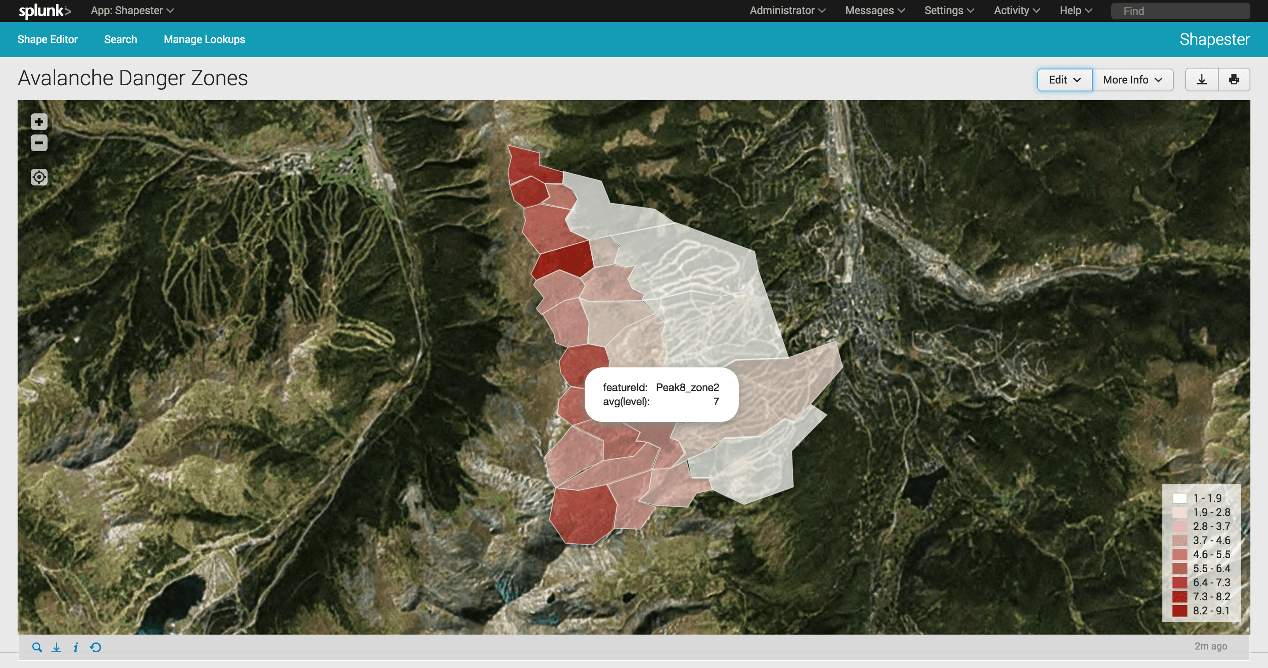
SHAPESTER EXAMPLE
Splunk App (2893)
This app lets you draw your own shapes and polygons directly on the map and save them as a geospatial lookup.
You can then use this lookup to set up alerts based on geo-fences. Or you can create a building map by drawing the buildings of your campus.
Example taken using GPS coordinates from a mobile team around Breckenridge Ski resort
Created Choropleth zones of different areas of the resort
Based on likely avalanche zones using other data
Source: http://blogs.splunk.com/2016/01/20/splunking-avalanches-of-data/

Slide 41
Data Enrichment New ideas

Slide 42
Data Enrichment New ideas
Use security researcher search engine’s to identify and track public information
Shodan
HL app
Direct query with local cache storage ideas
Censys

Slide 43
Shodan

Slide 44
Shodan – Google for Open-Source Intelligence
Shodan (http://shodan.io) – Search engine for security researchers
Functions like a search engine
Interrogates ports and grabs banners for collection
Data is gathered from Shodan crawlers that ‘walk’ the Internet IP space.
Designed to locate specific content and specific node information (desktops, servers, routers, etc)
Splunk and Shodan
Common app is Hurricane Labs search Add-on (1766)
Creates a new Splunk SPL keyword ‘shodan’ that allows to query an IP
Also used by Hurricane Labs Shodan App (1767)
Adaptive Response app available as well (3700)
Workflow action app (3509)
Notes:
Talk about registering for a Shodan account for an API key too, may be easy to add verbally but will prevent confusion

Slide 45
Shodan Examples
Search by IP ‘| shodan 4.4.4.4 ‘
Search by hostname/FQDN ‘| shodan badsite.com ‘
Pivot on larger grouping such as
BGP ASN (useful for grouping IP’s to larger ASN) ‘ my_search by src_ip | stats count by asn’
Geolocation (lat/long) - useful for geospatial bounding results ‘my_search | where Country=“Russia”
Map Bitcoin servers - search in Shodan (CLI or script or web) for popular bitcoin port 8333/tcp - Run scripted input to update list
* Place in a KV Store for larger data sets*
- Organize by geo-location, server type, etc
Shodan search for ‘lighttpd/1.4.32’
80.http.get.headers.www_authenticate= ‘antMiner’ 80.http.get.headers.server = ‘lighttpd/1.4.32’
Notes:
What about pivoting on servers listening on 1723 for a VPN for bad accesses; OR search on a tag in shodan like ics or camera;

Slide 46
Shodan Example – Gather list of antminers
sh-3.2# shodan search "lighttpd/1.4.32" AND "antminer">antminer_shodan_list_20Feb_2018.txt Example OUPTUT
171.244.44.50 80 HTTP/1.1 401 Unauthorized\r\nWWW-Authenticate: Digest realm="antMiner Configuration", nonce="c32f6cf3b1306fe89ee4e42fe2eca7a3", qop="auth"\r\nContent-Type: text/html\r\nContent-Length: 351\r\nDate: Sun, 09 Jan 2000 00:06:41 GMT\r\nServer: lighttpd/1.4.32\r\n\r\n
31.41.216.103 80 HTTP/1.1 401 Unauthorized\r\nWWW-Authenticate: Digest realm="antMiner Configuration", nonce="8d64634b86fd7e9139584a75683da9ea", qop="auth"\r\nContent-Type: text/html\r\nContent-Length: 351\r\nDate: Sun, 18 Feb 2018 17:59:11 GMT\r\nServer: lighttpd/1.4.32\r\n\r\n
219.151.23.205 80 HTTP/1.1 401 Unauthorized\r\nWWW-Authenticate: Digest realm="antMiner Configuration", nonce="459c170d1621be42afd523eb423bd8c3", qop="auth"\r\nContent-Type: text/html\r\nContent-Length: 351\r\nDate: Thu, 01 Jan 1970 10:14:31 GMT\r\nServer: lighttpd/1.4.32\r\n\r\n
96.92.84.205 3000 96-92-84-205-static.hfc.comcastbusiness.net HTTP/1.1 401 Unauthorized\r\nWWW-Authenticate: Digest realm="antMiner Configuration", nonce="9e0ceada5c09fd18bc498d83ff2bda11", qop="auth"\r\nContent-Type: text/html\r\nContent-Length: 351\r\nDate: Sun, 18 Feb 2018 07:35:34 GMT\r\nServer: lighttpd/1.4.32\r\n\r\n
93.178.219.116 8001 mail.zit.com.ua HTTP/1.1 401 Unauthorized\r\nWWW-Authenticate: Digest realm="antMiner Configuration", nonce="f0f028aac537dd98fe8e6fa709c5c7c0", qop="auth"\r\nContent-Type: text/html\r\nContent-Length: 351\r\nDate: Sun, 18 Feb 2018 07:18:28 GMT\r\nServer: lighttpd/1.4.32\r\n\r\n

Slide 47
Censys

Slide 48
Censys – a new search engine for researchers
“Censys is a search engine that allows computer scientists to ask questions about the devices and networks that compose the Internet. Driven by Internet-wide scanning, Censys lets researchers find specific hosts and create aggregate reports on how devices, websites, and certificates are configured and deployed.” states the description on the Censys official website.

Slide 49
Censys Grab SSL certificates that contain antminer
Using Python library for Censys
sh-3.2# python censys_io.py --api_id <MY_ID> --api_secret <MY_API_SECRET> -i "Let's Encrypt" antminer --limit 20 --verbose
Search limited to 20 results but output JSON (raw) data
Where the SSL issuer is the EFF’s ”Let’s Encrypt” free SSL CA
And where somewhere in the record it also contains the string ‘antminer’
Fun Result Example
Host in Germany
Victim’s Synology backup server ….
u'title': u'Hallo! Herzlich Willkommen bei Synology Web Station!'}}},
Check marks for Antminer web control
Right Web Server - u'server': u'lighttpd/1.4.32’,
Right HTTP authentication - u'www_authenticate': u'Digest realm="antMiner Configuration",
Wrap this in a script to collect the IP and drop into Splunk watchlist Adding IP, DNS name, and Country to the KV Store ‘antminercoll’
curl -k -u admin:changeme \https://localhost:8089/servicesNS/nobody/kvstoretest/storage/collections/data/antminercoll \-H 'Content-Type: application/json' \-d ‘{ “IP": ”217.72.209.42", ”Country": “Germany”, ”SSLCommonName": “loisl.ddnss.de”}'

Slide 50
More fun with Censys and Shodan
Tracking and Exploiting AntMiner and Claymore web backends https://medium.com/@s3yfullah/hacking-cryptocurrency-miners-with-osint-techniques-677bbb3e0157
In this example the Author’s are using the SHODAN search to find and exploit AntMiner poor web configurations to take over the Miner backend

Slide 51
Future Ideas
Add other data sources
SSL blocklist
Extract/compare with NIDS like Bro and Suricata for SSL certificate
Allow extra pivoting based on threat information sources
Notes:
Find IP addresses with default SSH or SSL keys on Censys and search for those as being malicious networks?

Slide 52
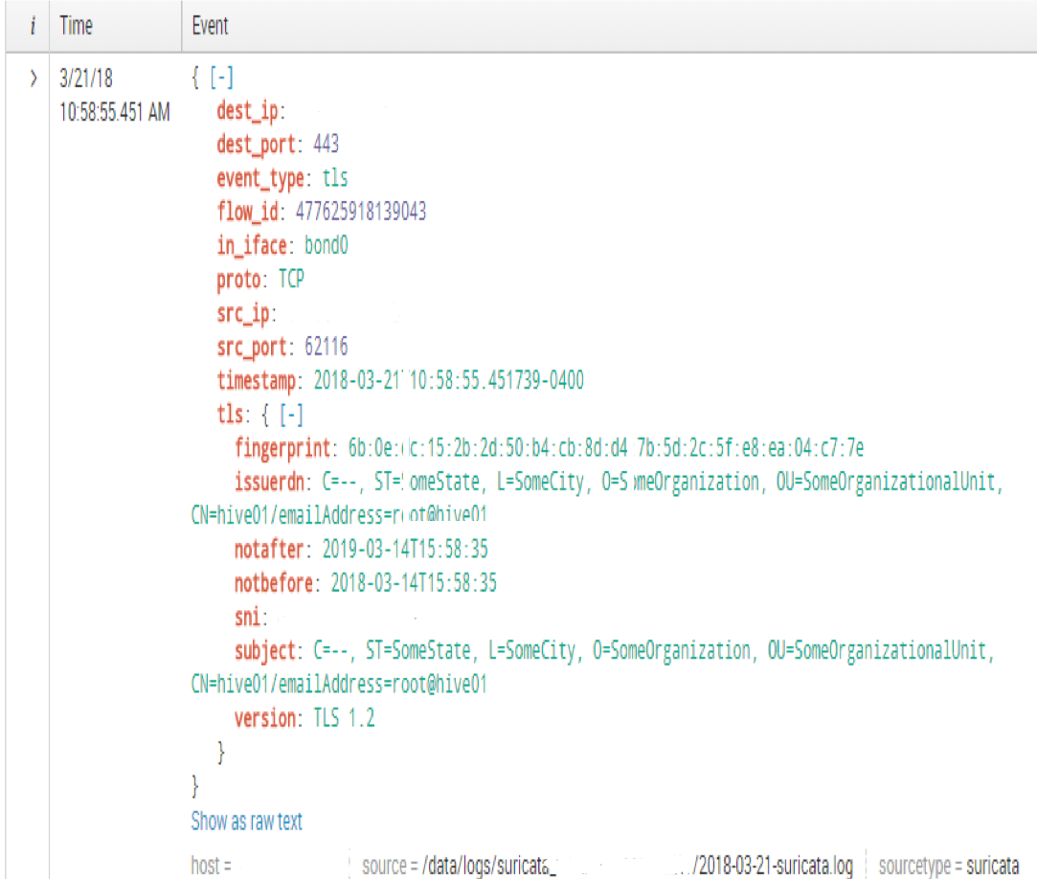
Suricata IDS
Network IDS that supports snort rules as well as protocol decoding.
Useful for grabbing SSL certificates
SSL Investigation and Matching Find all EFF ‘Let’s Encrypt’ certificates being used on US Gov’t servers
index=<CUSTOMER>_sec_suricata event_type=tls “Let’s encrypt” tls.sni=“*.gov”
Find Suspect certificates (PICTURE) Anything stand out as suspicious?
Self-signed SSL certificate
Fake state, city, organization, and conical name/server name

Slide 53
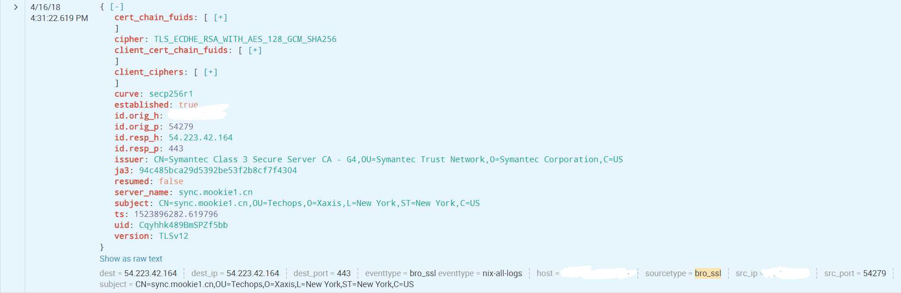
Bro IDS
BRO IDS – Application decoding platform
Processes Layer 4 to 7 traffic
Rebuilds, HTTP, SSL, FTP, SMTP, etc protocols
Think of manual process in Wireshark to ‘Follow TCP Stream’ or ‘Follow HTTP Stream’
This example Bro is parsing into Splunk SSL as ‘bro_ssl’
NOTE the “JA3” field that’s a method/tool to enable cataloging of SSL certificates for comparison with known lists

Slide 54
Hey There’s a Splunk Blog post about this exact thing!
https://www.splunk.com/blog/2017/12/18/configuring-ja3-with-bro-for-splunk.html
” They developedJA3,a technique for creating SSL client fingerprints from thepre-encryption handshakes of the SSL protocol. At this time, you cangenerate JA3 fingerprints with either a Bro JA3 scriptor customizing an instance of Suricata.”
What you need to know
Supports both BRO and Suricata
Creates and calculates an MD5 ’hash’ for an SSL certificate that can be searched by Splunk
Monitor via Lookup for example from list of JA3 certificates Example list - https://github.com/trisulnsm/trisul-scripts/blob/master/lua/frontend_scripts/reassembly/ja3/prints/ja3fingerprint.json
Title | Description | Value
ja3_version | SSL Version | 769
ja3_ciphers | SSL Cipher(s) | 47-53-5-10-49161-49162-49171-49172-50-56-19-4
ja3_extensions | SSL Extension | 0-10-11
ja3_ec | SSL Elliptic Curve | 23-24-25
ja3_ec_fmt | SSL Elliptic Curve PointFormat | 0
Notes:
Ja3 is MUCH better at client certificates but is a pretty badass tool
JA3 https://engineering.salesforce.com/open-sourcing-ja3-92c9e53c3c41
Github https://github.com/salesforce/ja3/tree/master/bro

Slide 55
Wrapping UP
Splunk is a powerful tool
When leveraged with 3rd party and data enrichment Splunk Security Users and Managers can more clearly defend their environment
Integration of Social Media information can provide useful information
Tracking threats, priority events, etc
News and information for situational awareness in the environment
Threat Intelligence comes in many forms that can be useful for Splunk
Leverage and use every component in your environment (Network IDS for example) to better defend the network(s).
Hopefully these demo’s and examples have given ideas to take–a-way for your environment.

Slide 56
Thank you Questions/Comments
Can’t think of something now? Ask me later Email: jake.babbin@copperriveres.com

